Slide 1
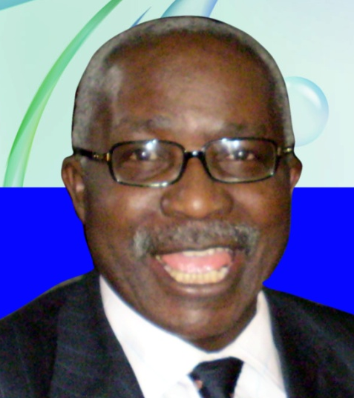
Prof. O.O. ADEWOYE (FAS) 1947-2015: SOME OF HIS LEGACIES IN ADVANCED MANUFACTURING TECHNOLOGY (AMT) DEVELOPMENT IN NIGERIA.
By Babaniyi Babatope
Ph.D, FMSN,FIMMM
Department of Physics and Engineering Physics
Obafemi Awolowo University, Ile-Ife. Nigeria
&
College of Natural and Applied Sciences, Wesley University, Ondo. Nigeria.
Formerly, Director/CEO, Engineering Materials Development Institute (EMDI) , Akure.

Slide 2
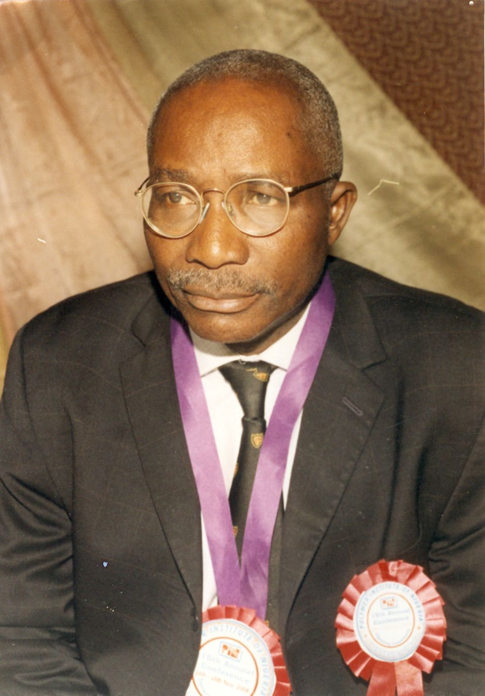
Prof. Olusegun Oyeleke Adewoye, FAS
1947 – 2015:
Professor of Materials, OAU, Ile-Ife. Nigeria;
Pioneer Director/CEO, EMDI, 1995-2003;
Director General/CEO, NASENI 2003 - 2012

Slide 3
ON THE POLICY OF AMT
‘The Policy on Technologies for SMEs seeks to reverse engineer, develop and proliferate technologies required by engineering based SMEs’.

Slide 4
‘Knowledge is More Important than Abundance of Raw Materials’
‘We must Vigorously Promote Local Content in Industrial Machinery’

Slide 5
TWO OF HIS MOST FAMOUS SLIDES

Slide 6
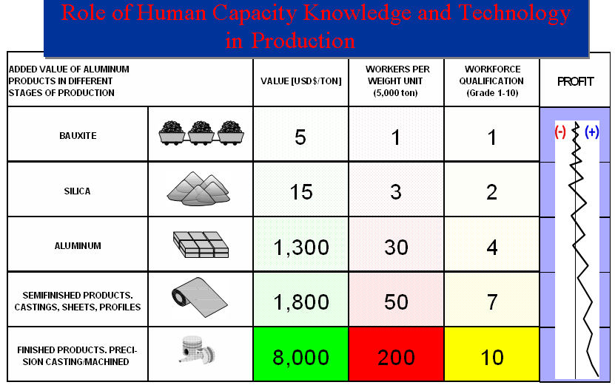

Slide 7
Number of years to double Per Capita Output
<number>

Slide 8
Conventional Technologies
Foundry Technology Education (Technical Schools and Polytechnics)
Furnace Technology Development
Mineral Processing and Alloy Development Technology (Precious Mineral Extraction & Beneficiation)
Composite Material Development
Value-Addition Technologies
Notes:
<number>

Slide 9
Investment in Emerging Technology Development
Nigeria is battling with the development of what the developed world may regard as conventional technologies;
The rest of the world is moving ahead with emerging technologies;
This further widens the technological divide.

Slide 10
Advanced Materials Development
These emerging technologies include
biotechnology, ICT,
Nanotechnology,
Space and Satellite Technology,
New Materials,
Robotics,
CAD/CAM,
Virtual Manufacturing Systems, etc.
Since these areas are capital intensive, there must be a special funding for the development of the EI required for these technologies.
Notes:
<number>

Slide 11
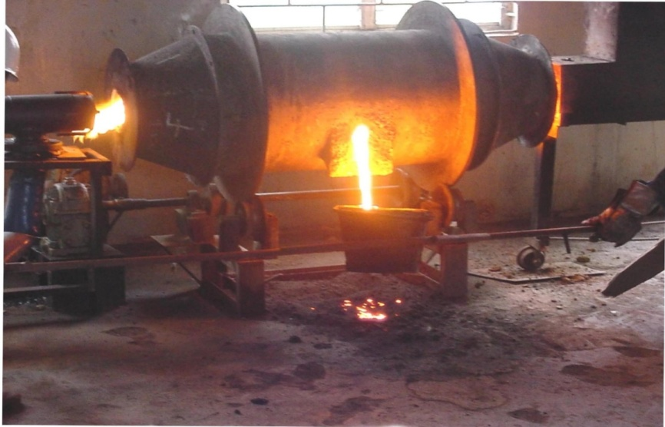
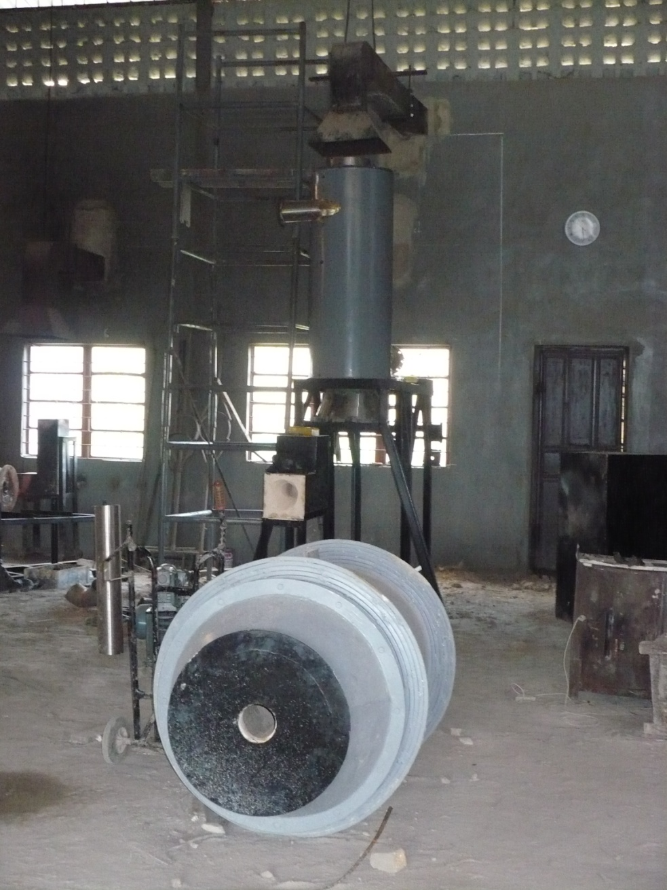
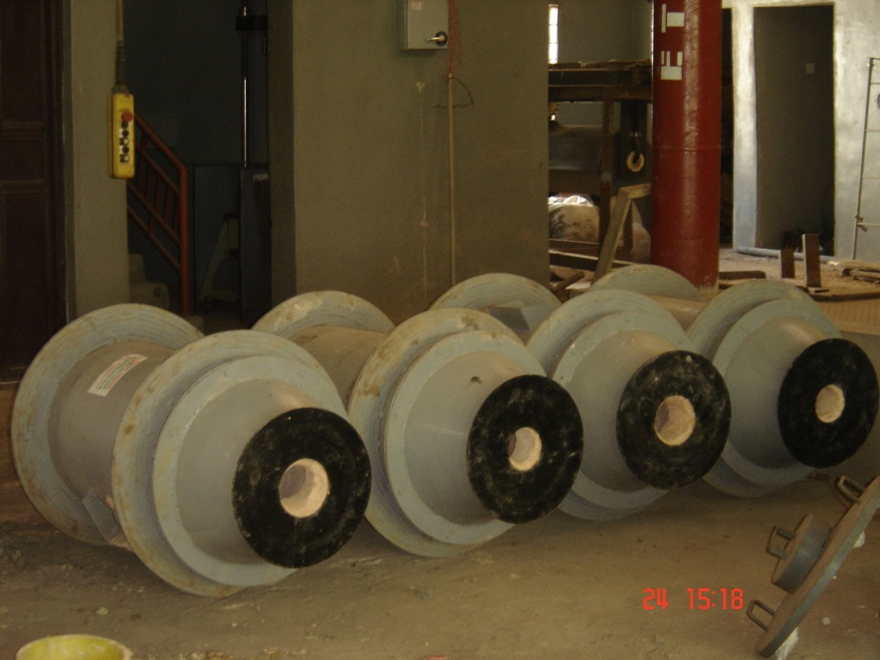
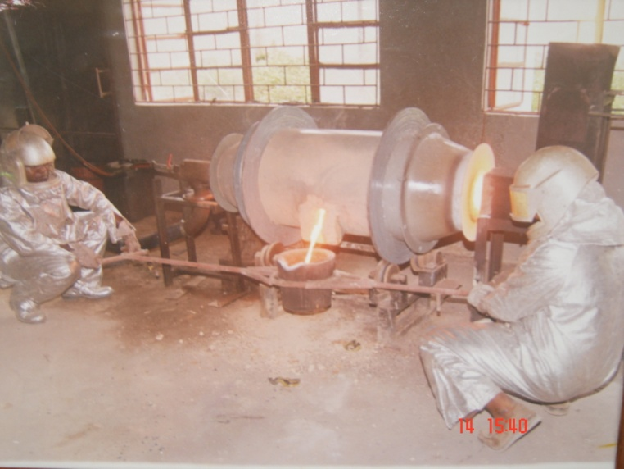
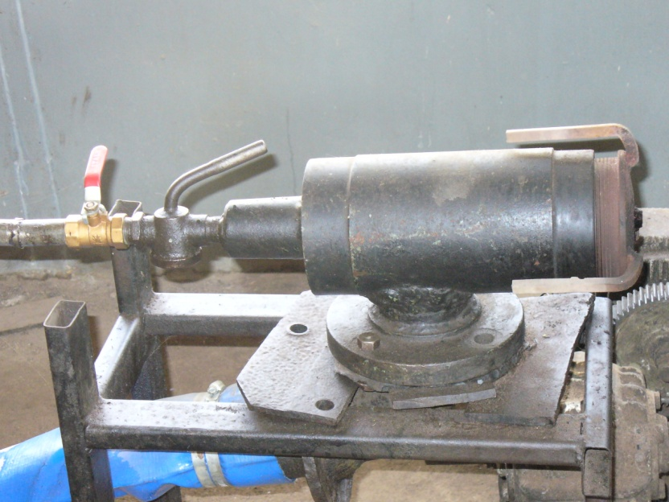
Rotary Furnaces: EMDI (1995-Date)
10Kg, 100Kg, 300Kg, 500Kg?

Slide 12
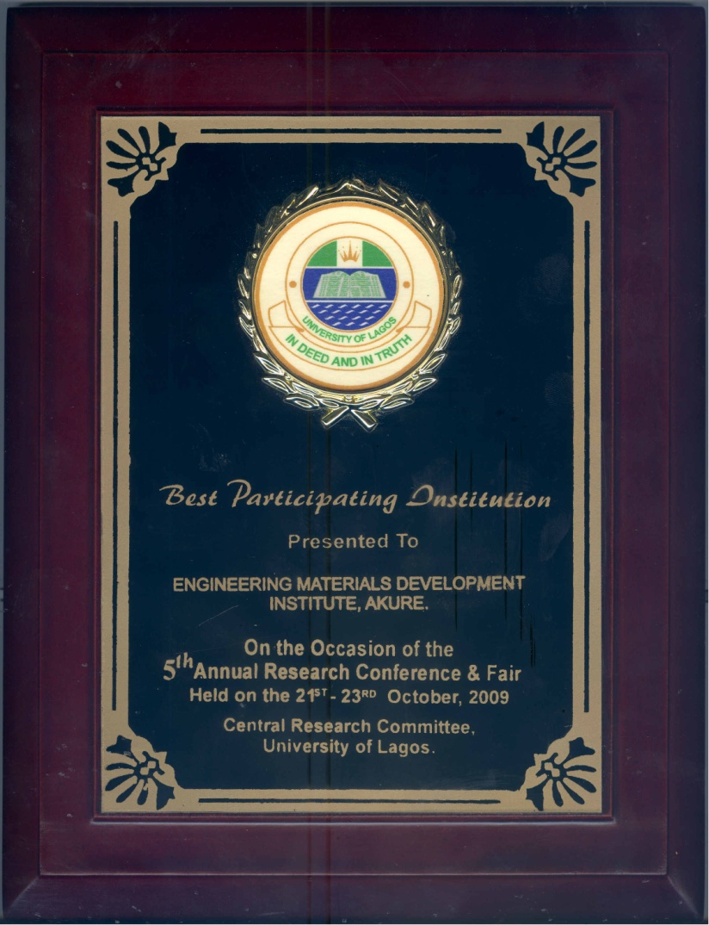
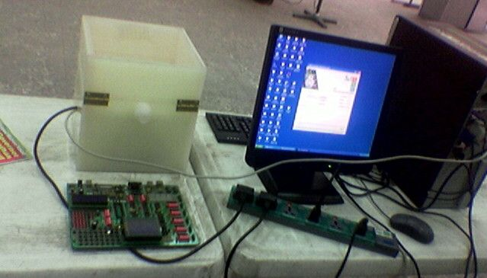
Spin Processor Development Project @EMDI (2007-2009)

Slide 13
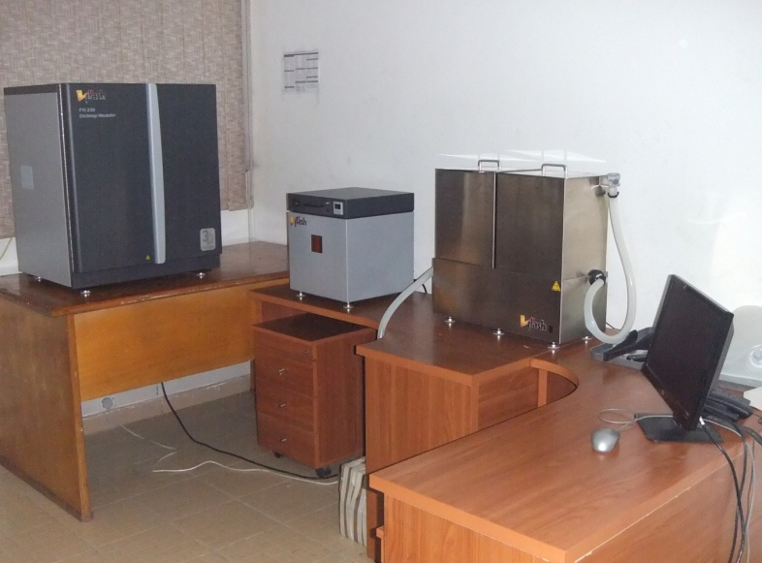
NASENI’S 3D PRINTER PRODUCTION SYSTEM @PEDI ILESA

Slide 14
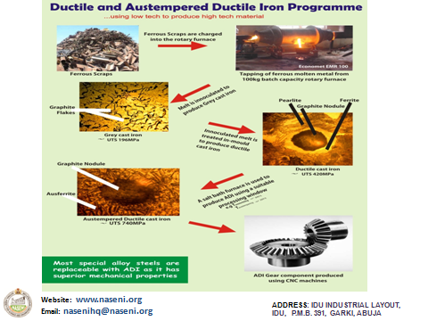

Slide 15
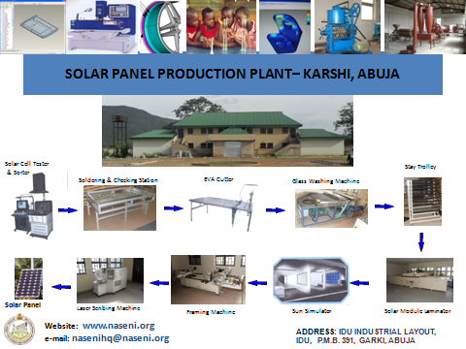

Slide 16
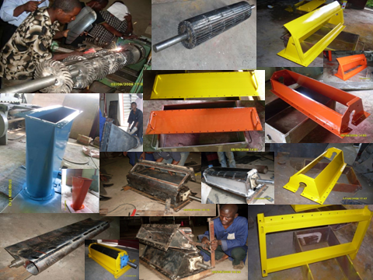
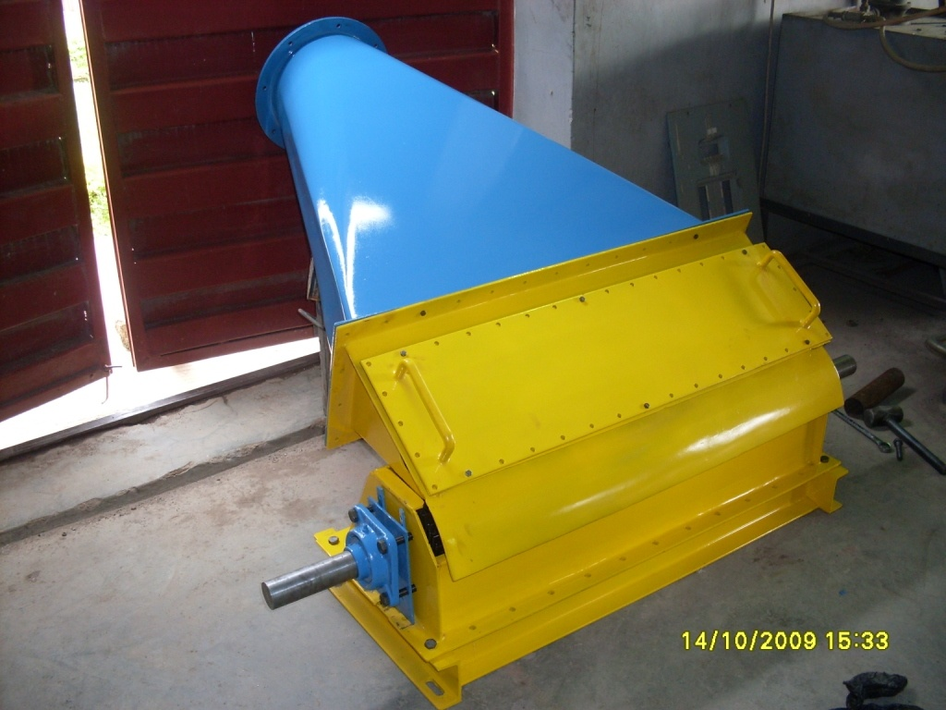
SMALL HYDRO-POWER TURBINE

Slide 17
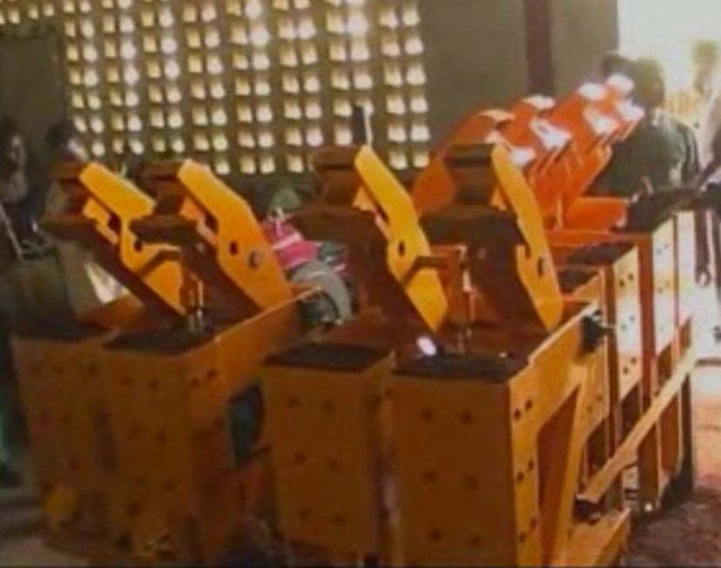
Development of Earth Brickmaking Machine
2-, 4-, 8- and 16 Mould Capacity

Slide 18
‘OO’ ADEWOYE’S PASSION FOR AMT
Prof. O.O. Adewoye believed that
1) All educational institutions Technical Colleges, Polytechnics and Universities and research institutes must convert to AMT with appropriate training.
2) These ones will go into the industry for necessary transformation.

Slide 19
Conclusion
Prof. ‘OO’ Has Always Believed that to achieve these lofty goals
All S&T based appointments must be strictly on MERIT–‘Right Peg in Right Hole’.
The economy must become technology-driven and so economists and world-class scientists of very high integrity must work hand-in-hand to drive the Nigerian economy for the future of generations to come.

Slide 20
My Mentor and Big Brother, ADIEU.

